Slide 1
Advisory Board: Camille Bartlett, Executive Director, Peabody TV
Curt Bellavance, Director of Community Development, City of Peabody
Tim Brown, Director of Innovation and Strategy, Northeast ARC
Martha Holden, Board Member, North Shore Children’s Museum
Leadership: Mayor Ted Bettencourt, City of Peabody Ali Haydock, Executive Director, North Shore Children’s Museum

Slide 2
Path to Permanence
LEVERAGE of resources:
Supportive municipality with a strong vision
Funders (ECCF)
Community member led pilot museum.

Slide 3
Path to Permanence
2011 – Mayor Ted Bettencourt elected as Mayor of Peabody. Revitalization of downtown is key priority.
2015 – Mayor Bettencourt and key stakeholders visit NH Children’s Museum.
2018 – Planning and seed funding for CuriousCity pop-up museum
2019 – Peabody Cultural Collaborative opens pop-up museum for 9 months
2020 – COVID-19 forces closure of CuriousCity, allows time for Mayor to evaluate long-term feasibility
2023 and beyond – Strengthen partnerships: funders, non-profits, schools.
Create foundation to ensure long-term stability and eventual roll into 501c3 status.
2022 – Lease signed by City of Peabody for 10 Main Street in February, ED hired in June, doors open in October

Slide 4
Partnerships

Slide 5
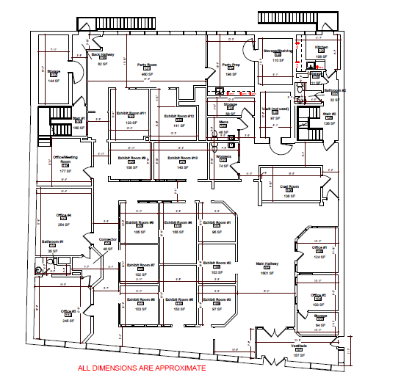
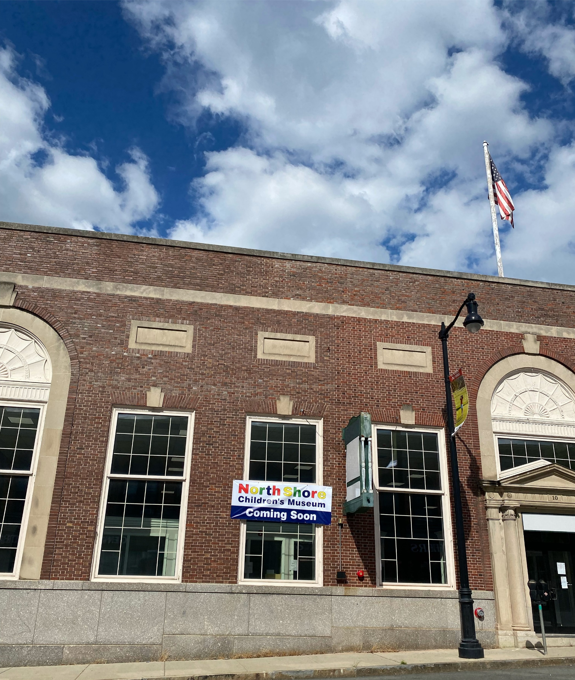
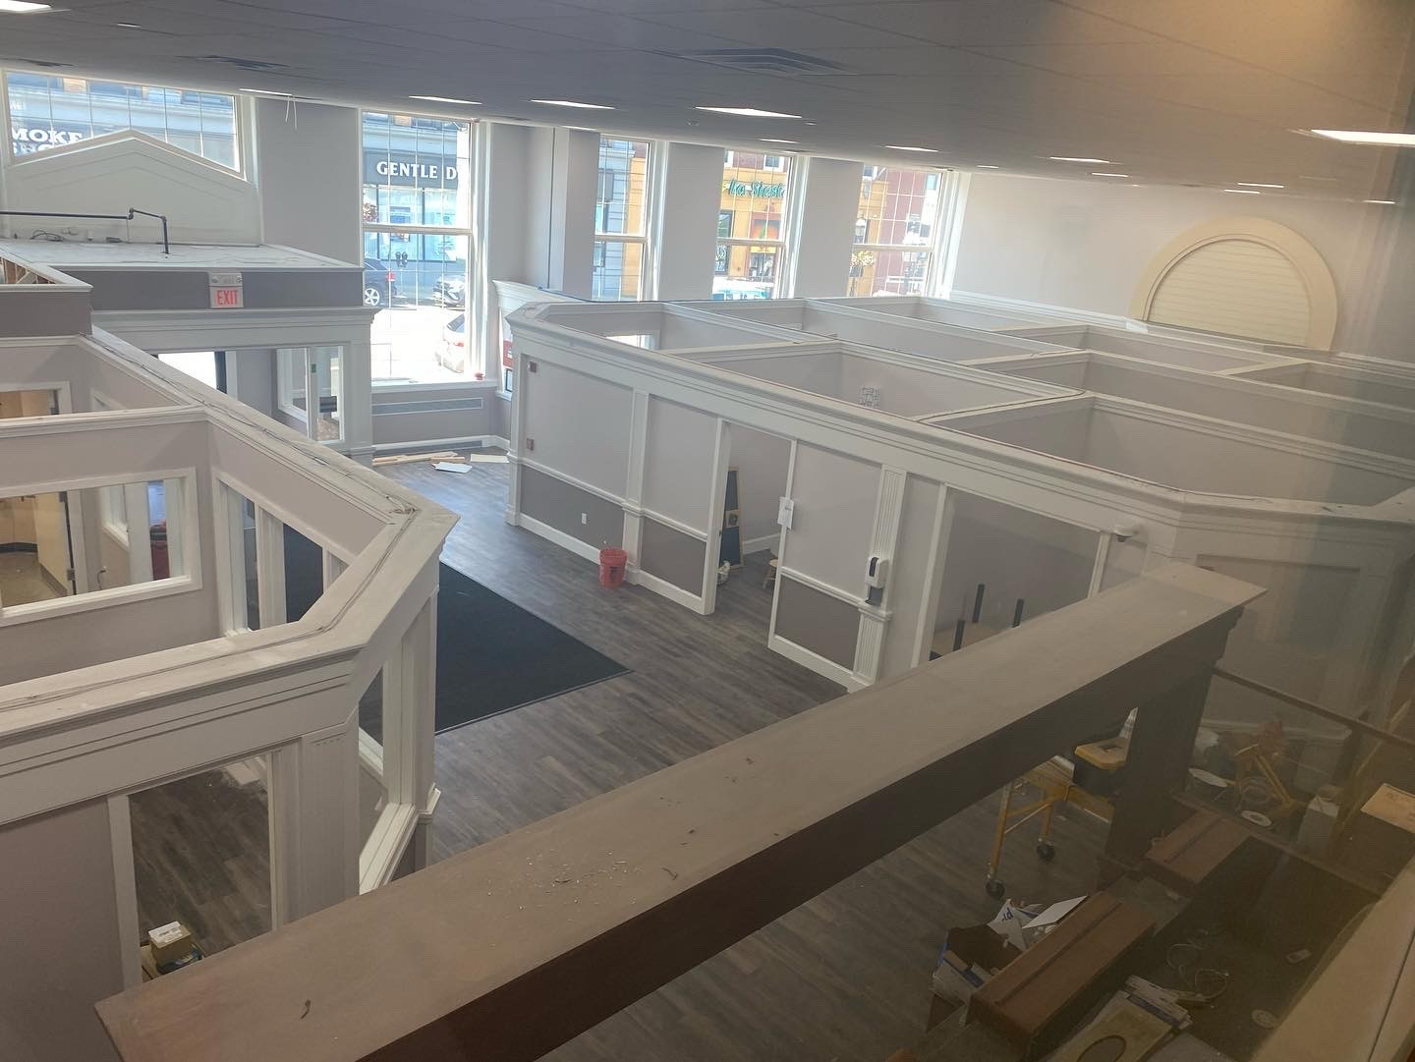
Permanent Location – 10 Main St, Peabody

Slide 6
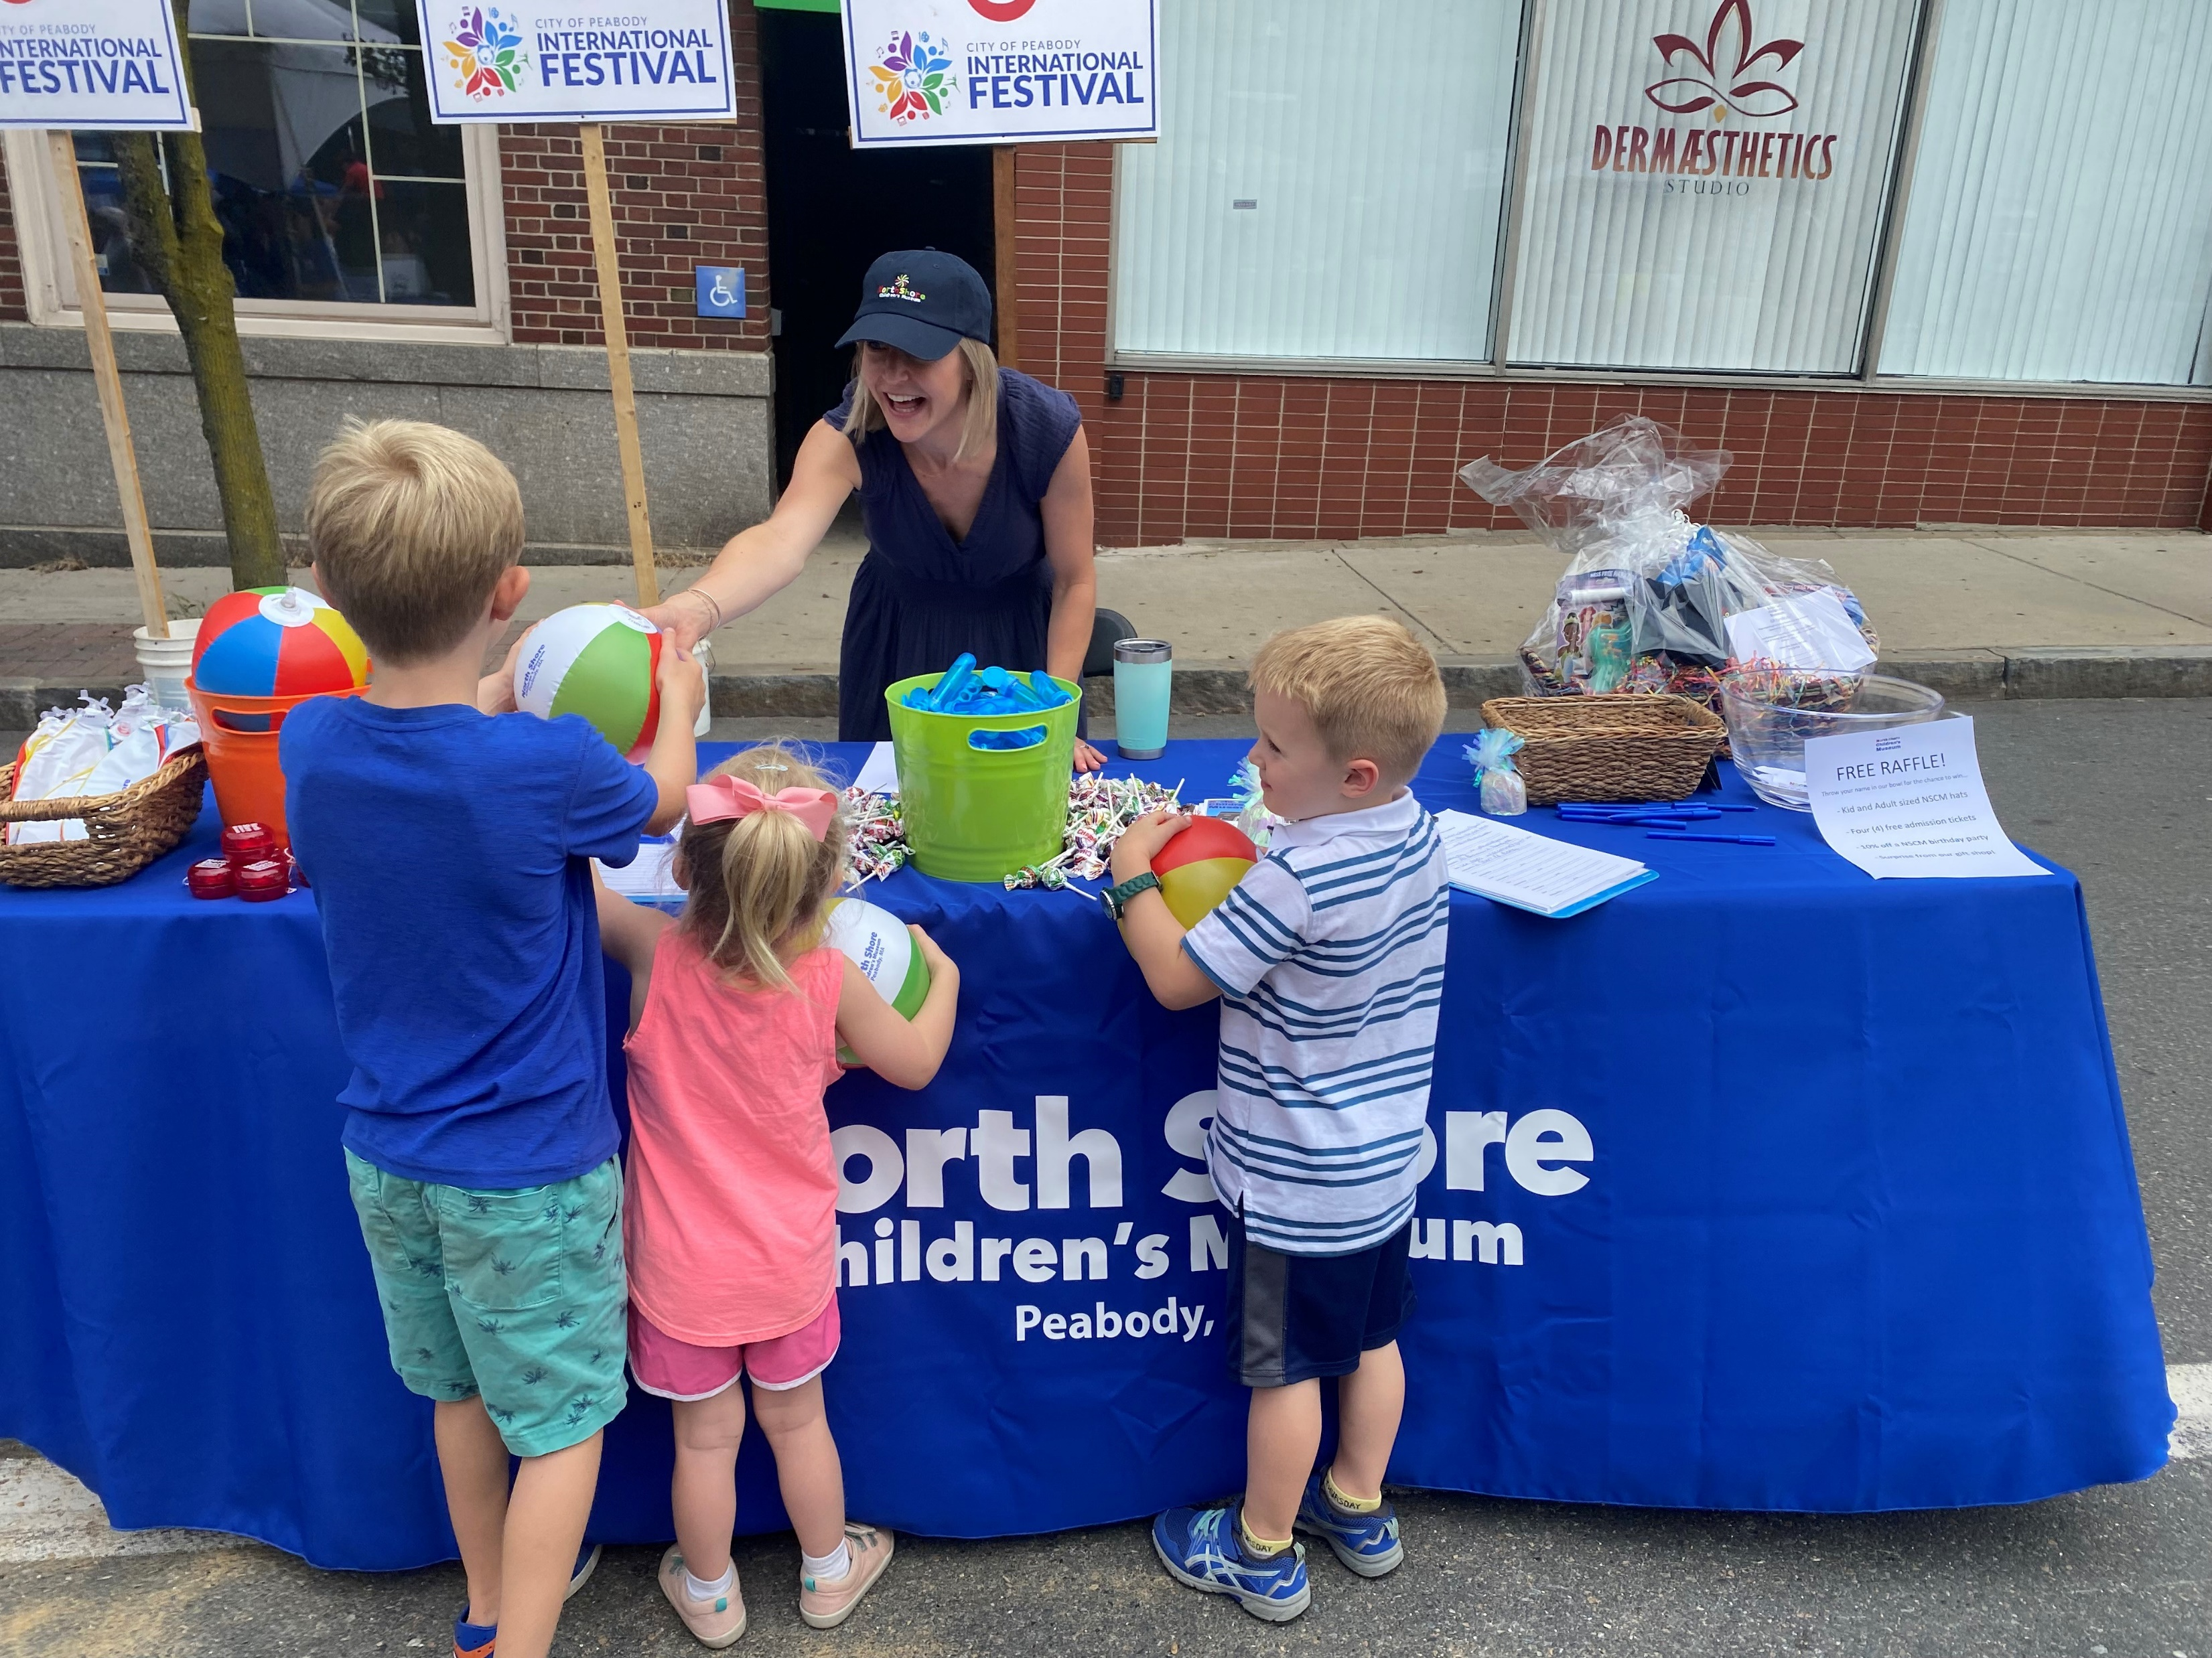
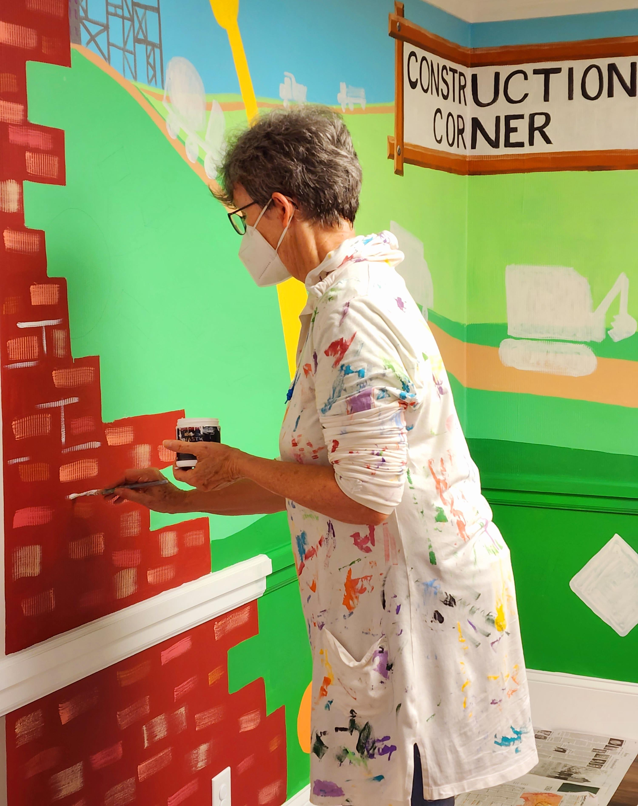
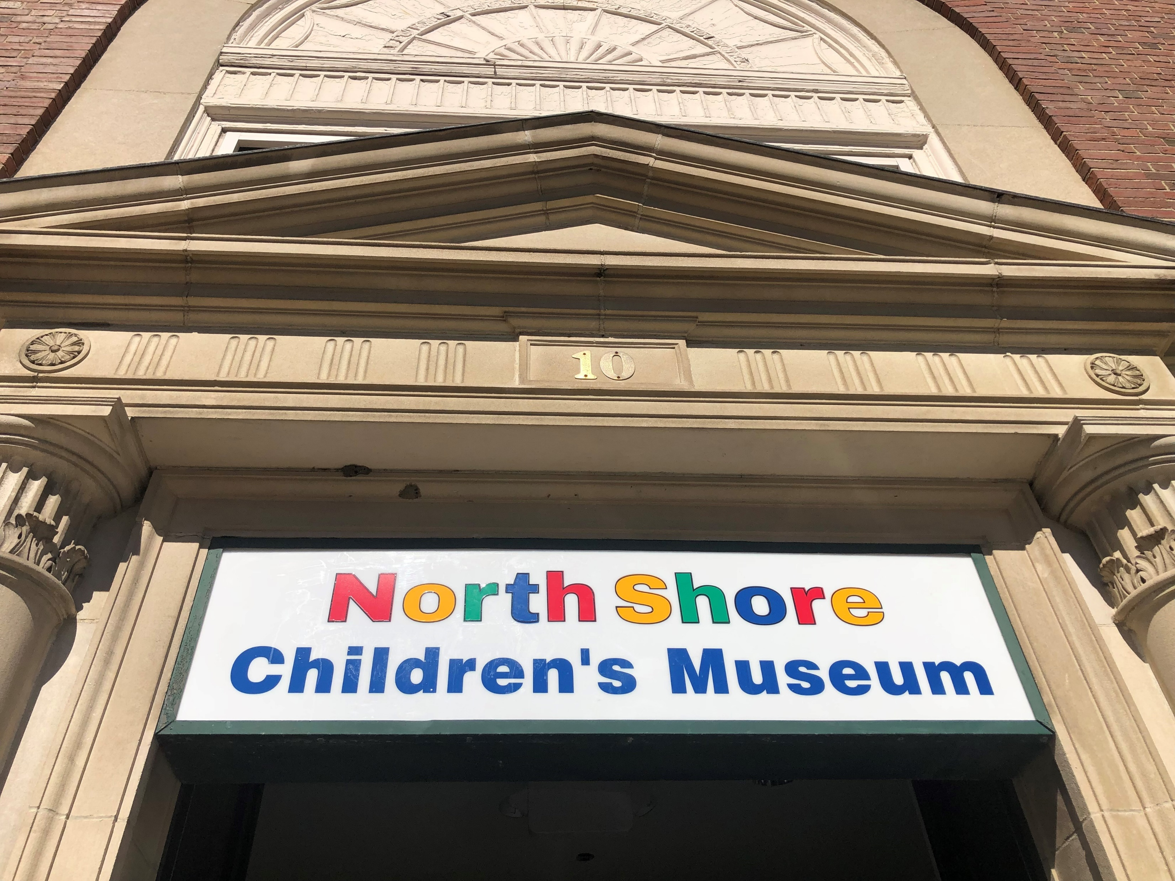
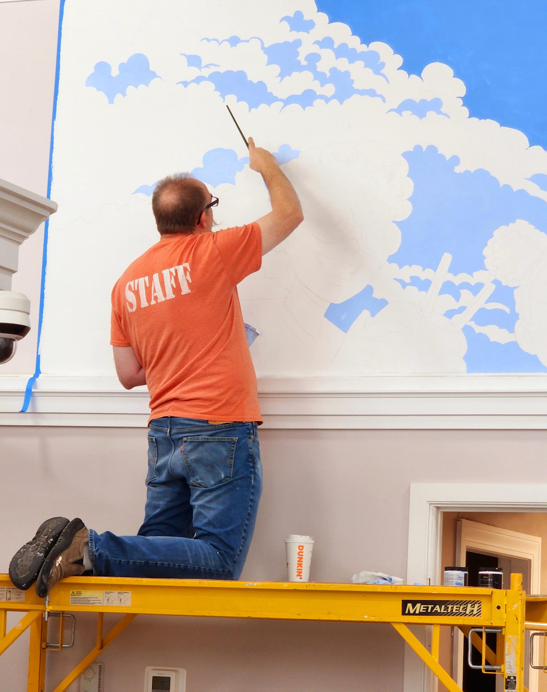
Getting Ready to Play at 10 Main St, Peabody

